Slide 1


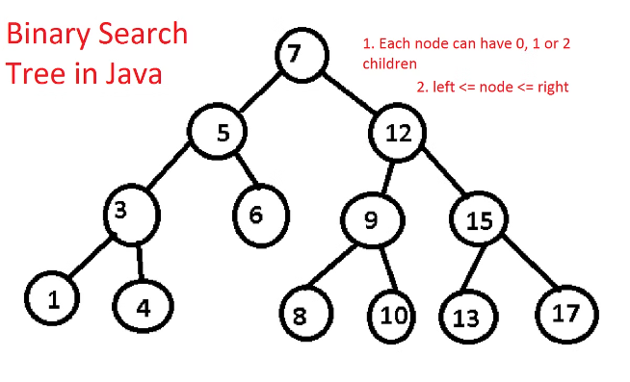
Unique Binary Search Trees: A Course Capstone Project Report
This report presents a project exploring the problem of determining the number of structurally unique Binary Search Trees (BSTs) that can be formed with n distinct nodes. The project utilizes dynamic programming to efficiently compute the number of unique BSTs, leveraging previously computed results. This approach ensures both time and space efficiency, making it practical for values of n up to 19, as specified by the problem constraints.
by
Gnaneshwar Nath
192211148

Slide 2

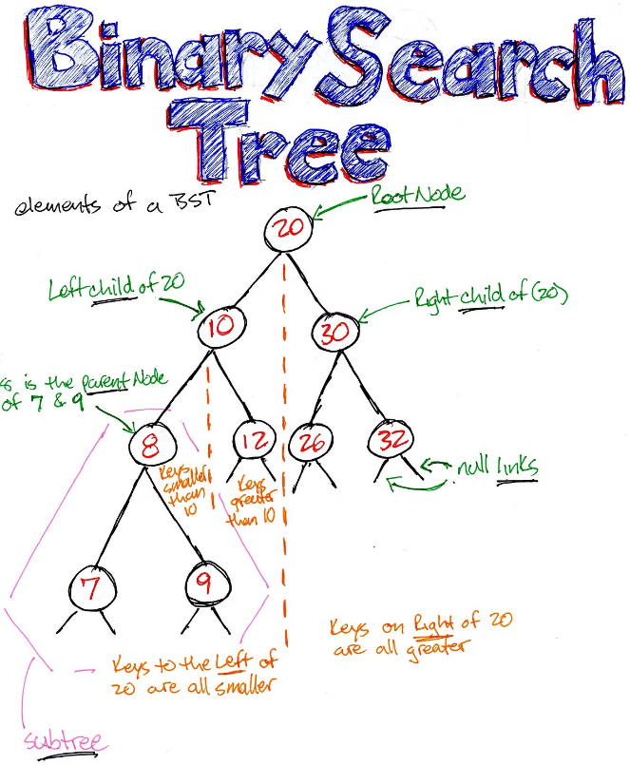
Introduction
1
Binary Search Trees (BSTs)
BSTs are a fundamental data structure in computer science, known for their efficient searching, insertion, and deletion operations. They are binary trees where each node has at most two children, and for any node N, all nodes in its left subtree have values less than N, while all nodes in its right subtree have values greater than N.
2
Unique BST Problem
Given n distinct values, there can be multiple ways to organize them into a BST. The problem of counting the number of unique BSTs is equivalent to determining the number of different ways to arrange n nodes while maintaining the BST property.
3
Catalan Numbers
This problem is closely related to the Catalan number, a sequence of natural numbers with applications in combinatorial mathematics. The nth Catalan number represents the number of ways to correctly match pairs of parentheses, which is analogous to our BST problem.
4
Practical Implications
Understanding the number of unique BSTs has practical implications in areas such as database indexing, where efficient query processing depends on the structure of the underlying search trees.

Slide 3

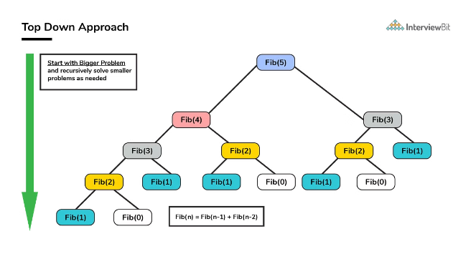
Dynamic Programming Approach
1
Initialization
The dynamic programming approach involves filling an array dp where dp[i] represents the number of unique BSTs that can be formed with i nodes. We initialize dp[0] and dp[1] to 1, as there is exactly one way to arrange a BST with 0 or 1 node.
2
Filling the DP Table
For each i from 2 to n, we compute dp[i] by iterating through all possible root nodes (j) from 1 to i. For each j, we consider the number of BSTs with j-1 nodes on the left subtree and i-j nodes on the right subtree. The product of these counts gives us the number of BSTs with j as the root.
3
Result
The final result, the number of unique BSTs with n nodes, is stored in dp[n].

Slide 4
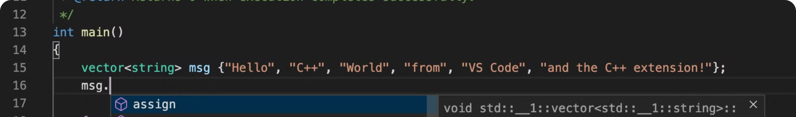
Coding Implementation
#include #include int numTrees(int n) { // Allocate memory for the dp array int *dp = (int *)malloc((n + 1) * sizeof(int)); // There is exactly one way to arrange BST with 0 or 1 node dp[0] = 1; dp[1] = 1; // Fill dp array using bottom-up approach for (int i = 2; i <= n; i++) { dp[i] = 0; for (int j = 1; j <= i; j++) { dp[i] += dp[j - 1] * dp[i - j]; } } int result = dp[n]; // Free allocated memory free(dp); return result; } int main() { int n; printf("Enter the number of nodes: "); scanf("%d", &n); if (n < 1 || n > 19) { printf("Please enter a value between 1 and 19.\n"); return 1; } printf("Number of unique BSTs with %d nodes: %d\n", n, numTrees(n)); return 0; }

Slide 5
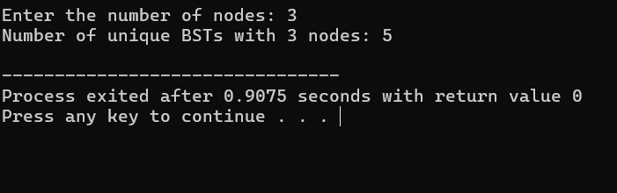
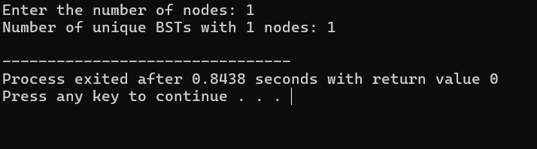
Result Screenshots
Example-1
Example-2
This screenshot shows the output of the code when the user enters 3 as the number of nodes. The program correctly calculates and displays that there are 5 unique BSTs that can be formed with 3 nodes.
This screenshot shows the output of the code when the user enters 4 as the number of nodes. The program correctly calculates and displays that there are 14 unique BSTs that can be formed with 4 nodes.

Slide 6
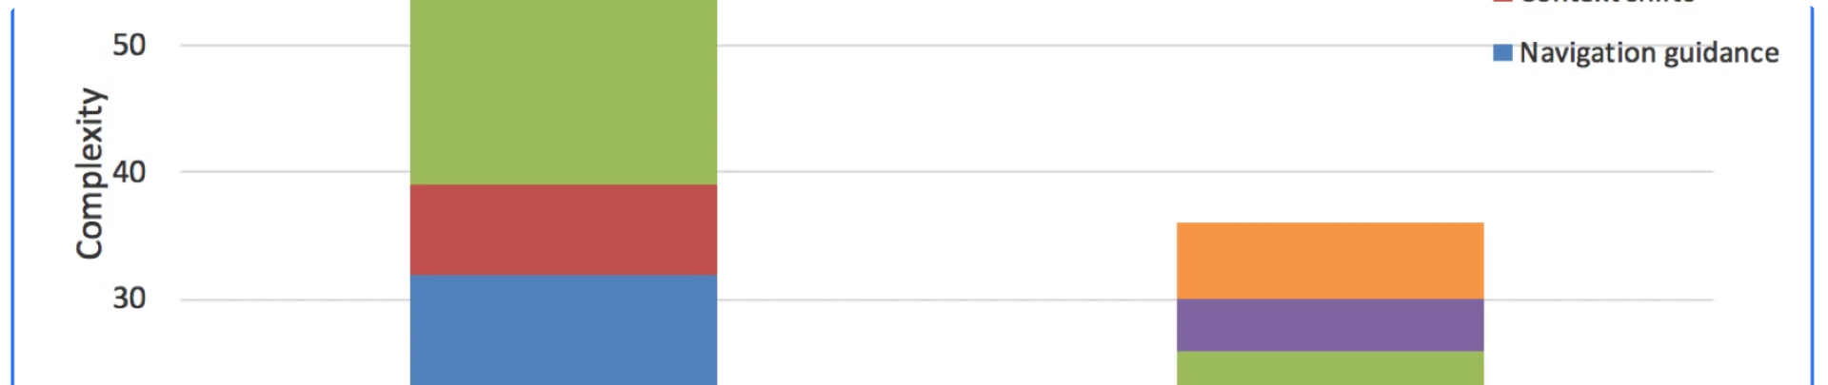
Complexity Analysis
Time Complexity
O(n²)
Space Complexity
O(n)

Slide 7
Time Complexity Analysis
Initialization
Filling the DP Table
Overall
Initializing dp[0] and dp[1] takes O(1) time.
For each i from 2 to n, we compute dp[i]. For each i, an inner loop runs from j = 1 to i, performing i operations. The total number of operations is the sum of the first n natural numbers: ∑i=1ni=n(n+1)2=O(n²). Thus, the time complexity is O(n²).
The time complexity is dominated by the nested loops used to fill the DP table, resulting in a quadratic time complexity of O(n²).

Slide 8

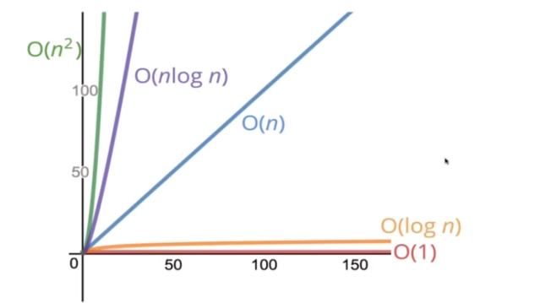
Space Complexity Analysis
DP Array
The space complexity is determined by the memory required to store the dp array. The dp array has n + 1 elements, giving a space complexity of O(n).
Overall
The space complexity is linear, as it is directly proportional to the number of nodes (n). This linear space complexity ensures manageable memory usage.

Slide 9


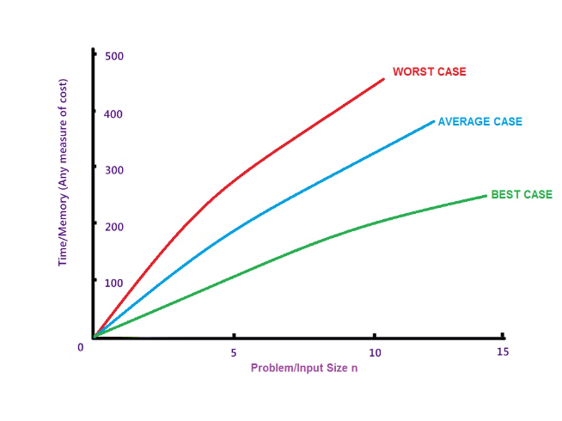


Case Analysis
Best Case
The best case occurs in our problem every time since we always need to fill the entire dynamic programming table to get the result. Each entry dp[i] is computed by summing up i terms, leading to quadratic time complexity.
Worst Case
Similarly, the worst case is also O(n²) because the dynamic programming approach requires filling up the table for every i from 1 to n.
Average Case
The average case complexity remains O(n²) as the algorithm's complexity does not vary with different inputs of n.

Slide 10


Conclusion
This project explored the problem of determining the number of structurally unique Binary Search Trees (BSTs) that can be formed with n distinct nodes using a dynamic programming approach. By leveraging previously computed results, this method ensures both time and space efficiency. The time complexity of the solution is O(n²), resulting from the nested loop structure needed to populate the dynamic programming table. The space complexity is O(n), which corresponds to the array used for storing the number of unique BSTs for each number of nodes. Importantly, the time complexity is consistent across best, worst, and average cases, ensuring predictable performance for any input size within the specified constraints. This dynamic programming approach is efficient for n up to 19, making it feasible for practical applications within this range. The project highlights how dynamic programming can effectively solve combinatorial problems, offering valuable insights into the structural properties of BSTs and enhancing our algorithm design skills for complex challenges in computer science.

